Slide 1
Bible Reading
Jeremy Graham

Slide 2
John 4:43-54
43 After the two days he left for Galilee. 44 (Now Jesus himself had pointed out that a prophet has no honour in his own country.) 45 When he arrived in Galilee, the Galileans welcomed him. They had seen all that he had done in Jerusalem at the Passover Feast, for they also had been there. 46 Once more he visited Cana in Galilee, where he had turned the water into wine. And there was a certain royal official whose son lay sick at Capernaum.
New International Version

Slide 3
John 4:43-54
47 When this man heard that Jesus had arrived in Galilee from Judea, he went to him and begged him to come and heal his son, who was close to death. 48 "Unless you people see miraculous signs and wonders," Jesus told him, "you will never believe." 49 The royal official said, "Sir, come down before my child dies."
New International Version

Slide 4
John 4:43-54
50 Jesus replied, "You may go. Your son will live." The man took Jesus at his word and departed. 51 While he was still on the way, his servants met him with the news that his boy was living. 52 When he inquired as to the time when his son got better, they said to him, "The fever left him yesterday at the seventh hour."
New International Version

Slide 5
John 4:43-54
53 Then the father realized that this was the exact time at which Jesus had said to him, "Your son will live." So he and all his household believed. 54 This was the second miraculous sign that Jesus performed, having come from Judea to Galilee.
New International Version

Slide 6
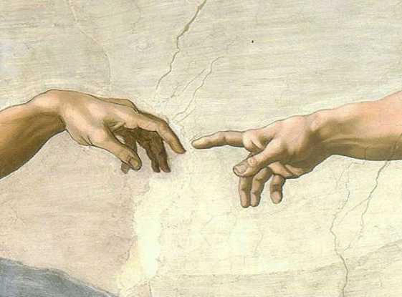
Saving Faith
John 4:43-54

Slide 7
Have you ever loved someone so much that you would go to extraordinary lengths to save them?

Slide 8
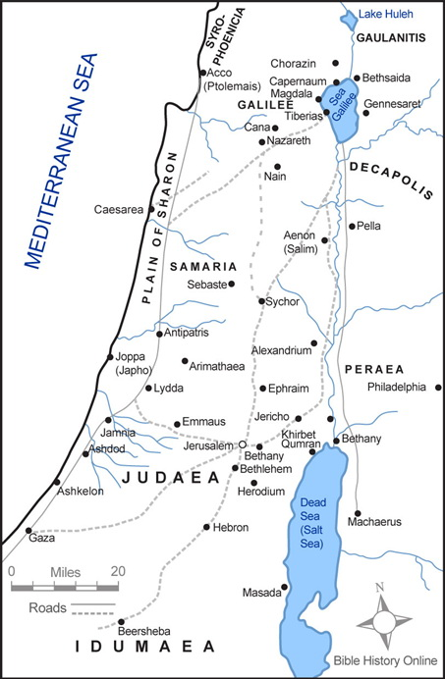
Where the Official meets Jesus(John 4:43-54)
Where Jesus speaks with the woman at the well
(John 4:1-42)
Where Jesus performed many miraculous signs during Passover
(John 2:13-25)

Slide 9
John 4:43-54
43 After the two days he left for Galilee. 44 (now Jesus himself had pointed out that a prophet has no honour in his own country.) 45 When he arrived in Galilee, the Galileans welcomed him. They had seen all that he had done in Jerusalem at the Passover feast, for they also had been there.
New International Version

Slide 10
John 4:43-54
43 After the two days he left for Galilee. 44 (now Jesus himself had pointed out that a prophet has no honour in his own country.) 45 When he arrived in Galilee, the Galileans welcomed him. They had seen all that he had done in Jerusalem at the Passover feast, for they also had been there.
New International Version

Slide 11
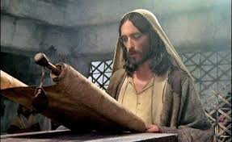
Matthew 13:54
Coming to his hometown, he began teaching the people in their synagogue and they were amazed “Where did this man get this wisdom and these miraculous powers?”
New International Version

Slide 12
Matthew 13:55-57
55“Isn’t this the carpenter’s son? Isn’t his mother’s name Mary, and aren’t his brothers James, Joseph, Simon and Judas? 56 Aren’t all his sisters with us? Where then did this man get all these things?” 57 And they took offense at him. But Jesus said to them, “A prophet is not without honour except in his own town and in his own home.”
New International Version

Slide 13
John 4:43-54
48 “Unless you people see miraculous signs and wonders,” Jesus told him, “you will never believe.” 49 The royal official said, “Sir, come down before my child dies.” 50 Jesus replied, “You may go. Your son will live.” The man took Jesus at his word and departed.
New International Version

Slide 14
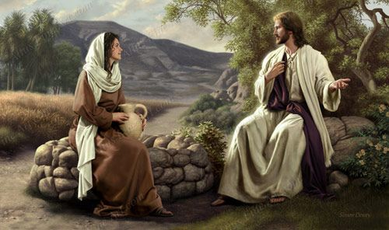
John 4:39-41
39 Many of the Samaritans from that town believed in him because of the woman’s testimony, “He told me everything I ever did.” 40 So when the Samaritans came to him, they urged him to stay with them, and he stayed two days. 41 And because of his words many more became believers.
New International Version

Slide 15
John 4:42
42 They said to the woman, “We no longer believe just because of what you said; now we have heard for ourselves, and we know that this man really is the Saviour of the world.”
New International Version

Slide 16
John 4:43-54
51 While he was still on the way, his servants met him with the news that his boy was living. 52 When he inquired as to the time when his son got better, they said to him, “The fever left him yesterday at the seventh hour.”
53 Then the father realised that this was the exact time at which Jesus had said to him, “Your son will live.” So he and all his household believed.
New International Version

Slide 17
Ephesians 2:8-9
8 For it is by grace you have been saved, through faith - and this is not from yourselves, it is the gift of God - 9 not by works, so that no one can boast.
New International Version

Slide 18
Hebrews 11:1
1 Now faith is confidence in what we hope for and assurance in what we do not see.
New International Version

Slide 19
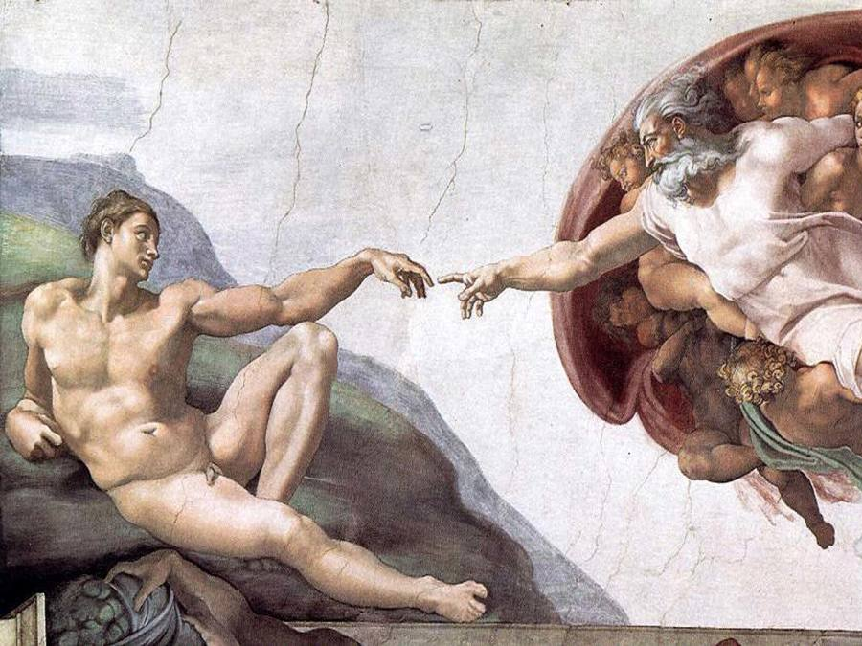

Slide 20
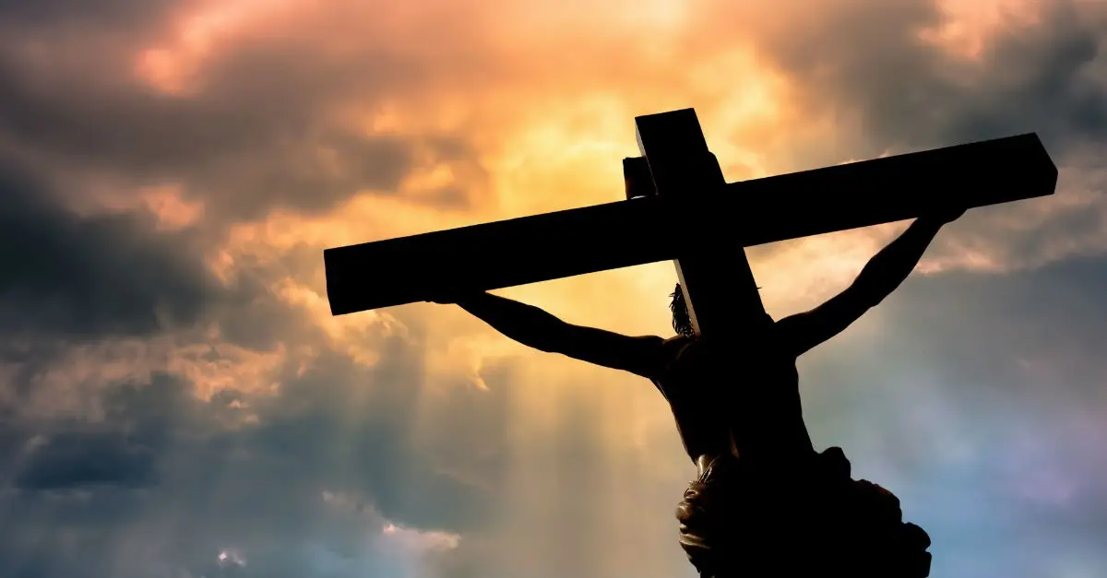
John 3:16
16 For God so loved the world that he gave his one and only Son, that whoever believes in him shall not perish but have eternal life.
New International Version

